Slide 1
Algorithms
Lecture 3
Global Frontier College

Slide 2
Running Time
The running time depends on the input: an already sorted sequence is easier to sort.
Parameterize the running time by the size of the input, since short sequences are easier to sort than long ones.
Generally, we seek upper bounds on the running time, because everybody likes a guarantee.

Slide 3
Kinds of analyses
Worst-case: (usually)
T(n) = maximum time of algorithm on any input of size n.
Average-case: (sometimes)
T(n) = expected time of algorithm over all inputs of size n.
Need assumption of statistical distribution of inputs.
Best-case:
Cheat with a slow algorithm that Works fast on some input.

Slide 4
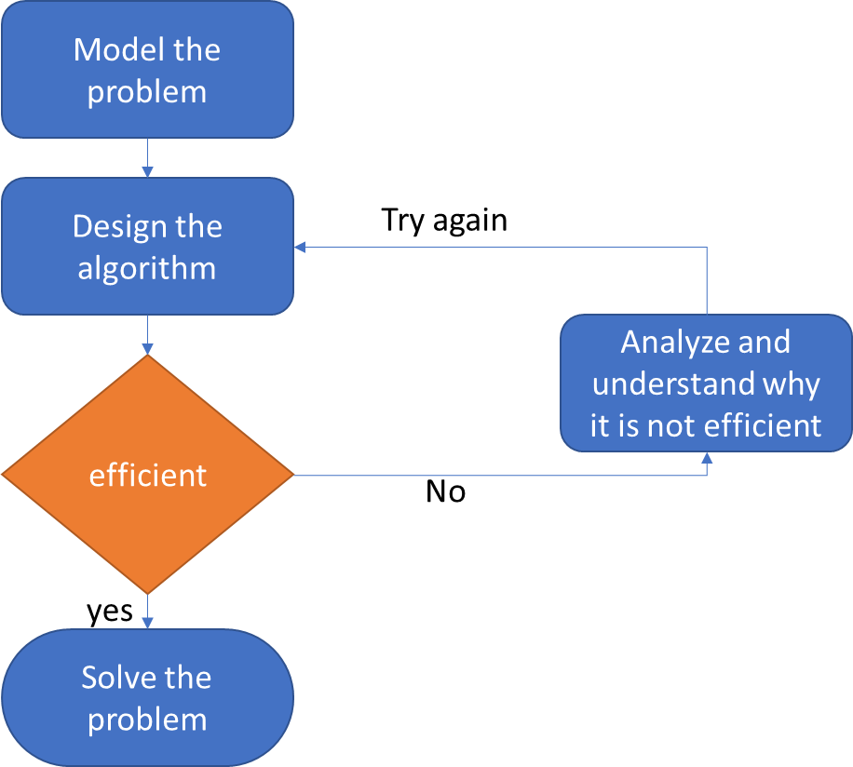
Union-Find
Dynamic connectivity
Quick find
Quick union
Improvements
applications

Slide 5
UNION-FIND
Given a set of N objects.
Union command: connect two objects.
Find/connected query: is there a path connecting the two objects?
union(4, 3)
union(3, 8)
union(6, 5)
0
1
2
3
4
union(9, 4)
union(2, 1)
connected(0, 7)
No
5
6
7
8
9
connected(8, 9)
Yes
union(5, 0)
union(7, 2)
union(6, 1)
union(1, 0)
connected(0, 7)
Yes

Slide 6
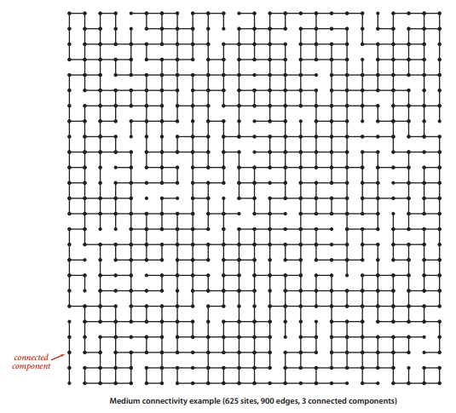
Applications of Union-Find algorithm

Slide 7
Applications of Union-Find algorithm
Pixels in a digital photo.
Computers in a network.
Friends in a social network.
Transistors in a computer chip.
Elements in a mathematical set.
Metallic sites in a composite system.

Slide 8
Modeling the connections
We assume "is connected to" is an equivalence relation:
Reflexive: p is connected to p.
Symmetric: if p is connected to q, then q is connected to p.
Transitive: if p is connected to q and q is connected to r, then p is connected to r.
Connected components: Maximal set of objects that are mutually connected.
0
1
2
6
4
5
3
7
3 connected components:
{ 0 } { 1 4 5 } { 2 3 6 7 }

Slide 9
Implementing the operations
Find query. Check if two objects are in the same component.
Union command. Replace components containing two objects with their union.
0
1
2
6
0
1
2
6
union(2, 5)
4
5
3
7
4
5
3
7
3 connected components:
{ 0 } { 1 4 5 } { 2 3 6 7 }
{ 0 } { 1 2 3 4 5 6 7 }

Slide 10
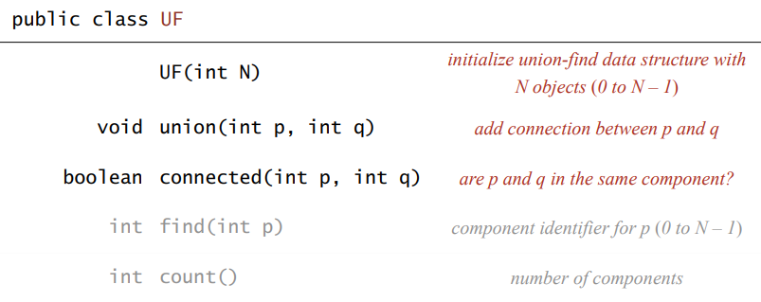
Implementing the operations
Goal. Design efficient data structure for union-find.
Number of objects N can be huge.
Number of operations M can be huge.
Find queries and union commands may be intermixed.

Slide 11
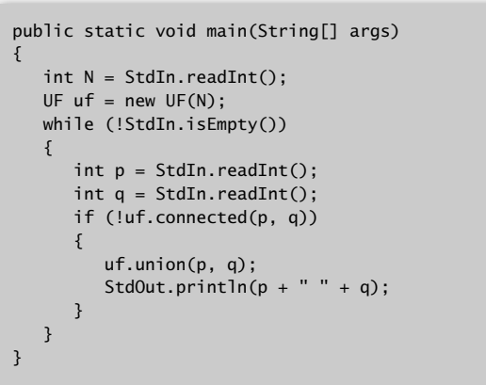
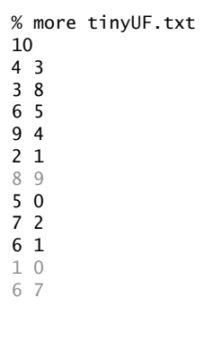
Dynamic-connectivity client
Read in number of objects N from standard input.
Repeat:
read in pair of integers from standard input
if they are not yet connected, connect them and print out pair

Slide 12
Quick-find
Data structure.
Integer array id[] of length N.
Interpretation: p and q are connected iff (if and only if) they have the same id.
0 | 1 | 2 | 3 | 4 | 5 | 6 | 7 | 8 | 9
0, 5 and 6 are connected
1, 2, and 7 are connected
3, 4, 8, and 9 are connected
id[]
0 | 1 | 1 | 8 | 8 | 0 | 0 | 1 | 8 | 8
0
1
2
3
4
5
6
7
8
9

Slide 13
Quick-find
Data structure.
Integer array id[] of length N.
Interpretation: p and q are connected iff (if and only if) they have the same id.
0 | 1 | 2 | 3 | 4 | 5 | 6 | 7 | 8 | 9
0, 5 and 6 are connected
1, 2, and 7 are connected
3, 4, 8, and 9 are connected
id[]
0 | 1 | 1 | 8 | 8 | 0 | 0 | 1 | 8 | 8

Slide 14
Quick-find
Data structure.
Integer array id[] of length N.
Interpretation: p and q are connected iff (if and only if) they have the same id.
Find. Check if p and q have the same id.
id[6] = 0; id[1] = 1
6 and 1 are not connected
0 | 1 | 2 | 3 | 4 | 5 | 6 | 7 | 8 | 9
0, 5 and 6 are connected
1, 2, and 7 are connected
3, 4, 8, and 9 are connected
id[]
0 | 1 | 1 | 8 | 8 | 0 | 0 | 1 | 8 | 8

Slide 15
Quick-find
Data structure.
Integer array id[] of length N.
Interpretation: p and q are connected iff (if and only if) they have the same id.
Union. To merge components containing p and q, change all entries whose id equals id[p] to id[q].
0 | 1 | 2 | 3 | 4 | 5 | 6 | 7 | 8 | 9
0, 5 and 6 are connected
1, 2, and 7 are connected
3, 4, 8, and 9 are connected
id[]
0 | 1 | 1 | 8 | 8 | 0 | 0 | 1 | 8 | 8
0 | 1 | 2 | 3 | 4 | 5 | 6 | 7 | 8 | 9
union(6 and 1)
id[]
1 | 1 | 1 | 8 | 8 | 1 | 1 | 1 | 8 | 8
problem: many values can change

Slide 16
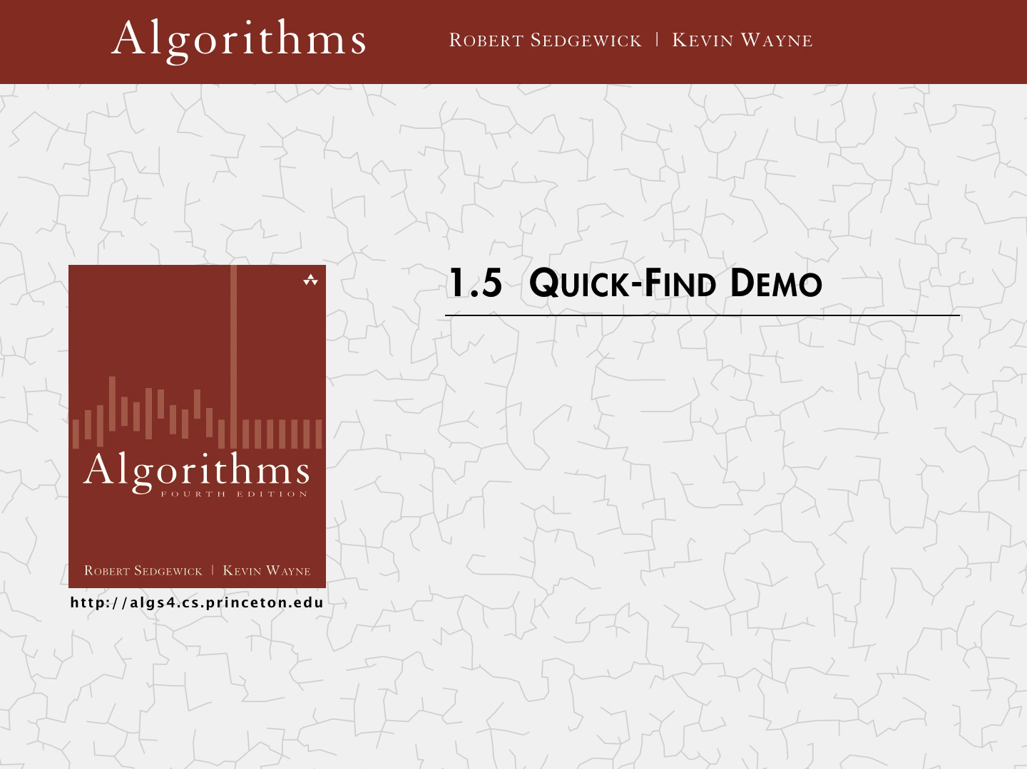

Slide 17
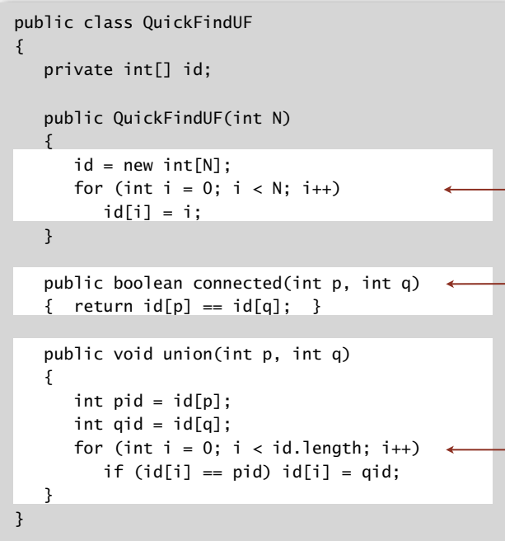
Quick-find: Java implementation
set id of each object to itself
(N array accesses)
check whether p and q
are in the same component
(2 array accesses)
change all entries with id[p] to id[q]
(at most 2N + 2 array accesses)

Slide 18
Quick-find is too slow
Cost model. Number of array accesses (for read or write).
algorithm | initialize | union | find
quick-find | N | N | 1
Union is too expensive. It takes N² array accesses to process a sequence of
N union commands on N objects.

Slide 19
Quadratic algorithms do not scale
Rough standard (for now).
10⁹ operations per second.
10⁹ words of main memory.
Touch all words in approximately 1 second.
Ex. Huge problem for quick-find.
10⁹ union commands on 10⁹ objects.
Quick-find takes more than 10¹⁸ operations.
30+ years of computer time!
Quadratic algorithms don't scale with technology.
New computer may be 10x as fast.
But, has 10x as much memory ⇒ want to solve a problem that is 10x as big.
With quadratic algorithm, takes 10x as long!

Slide 20
Quadratic algorithms do not scale
time
quadratic
linearithmic
linear
size

Slide 21
Quick-find: Java implementation
0 | 1 | 2 | 3 | 4 | 5 | 6 | 7 | 8 | 9
id[]
0 | 1 | 1 | 8 | 8 | 0 | 0 | 1 | 8 | 8
0 | 1 | 2 | 3 | 4 | 5 | 6 | 7 | 8 | 9
id[]
1 | 1 | 1 | 8 | 8 | 1 | 1 | 1 | 8 | 8
union(6 and 1)
set id of each object to itself
(N array accesses)
check whether p and q
are in the same component
(2 array accesses)
change all entries with id[p] to id[q]
(at most 2N + 2 array accesses)

Slide 22
Quick-find is too slow
Cost model. Number of array accesses (for read or write).
algorithm | initialize | union | find
quick-find | N | N | 1
Union is too expensive. It takes N² array accesses to process a sequence of
N union commands on N objects.

Slide 23
Quadratic algorithms do not scale
time
quadratic
linearithmic
linear
size

Slide 24
Quick-union
0
1
9
6
7
8
2
4
5
Data structure.
Integer array id[] of length N.
Interpretation: id[i] is parent of i.
Root of i is id[id[id[…id[i]….]]].
Find. Check if p and q have the same root
3
0 | 1 | 2 | 3 | 4 | 5 | 6 | 7 | 8 | 9
id[]
0 | 1 | 9 | 4 | 9 | 6 | 6 | 7 | 8 | 9
root of 3 is 9
root of 5 is 6
3 and 5 are not connected

Slide 25
Example
0 | 1 | 2 | 3 | 4 | 5 | 6 | 7 | 8 | 9
id[]
0 | 9 | 6 | 5 | 9 | 2 | 6 | 1 | 8 | 5
Which are the roots of 3 and 7, respectively?
The root of 3 is 6: 3→5→2→6.
The root of 7 is 6: 7→1→9→5→2→6.

Slide 26
Quick-union
0
1
6
7
8
9
5
Data structure.
Integer array id[] of length N.
Interpretation: id[i] is parent of i.
Root of i is id[id[id[…id[i]….]]].
Union. To merge components containing p and q, set the id of p's root to the id of q's root.
2
4
3
0 | 1 | 2 | 3 | 4 | 5 | 6 | 7 | 8 | 9
id[]
0 | 1 | 9 | 4 | 9 | 6 | 6 | 7 | 8 | 9

Slide 27


Slide 28
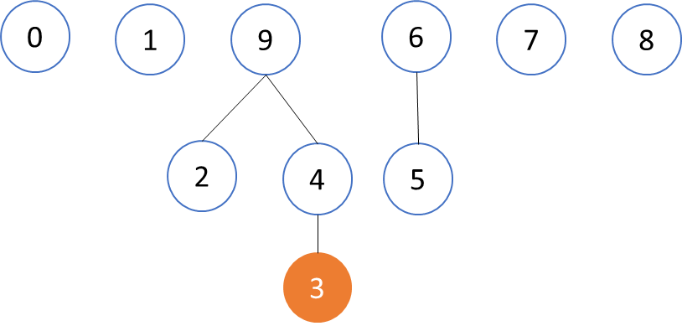
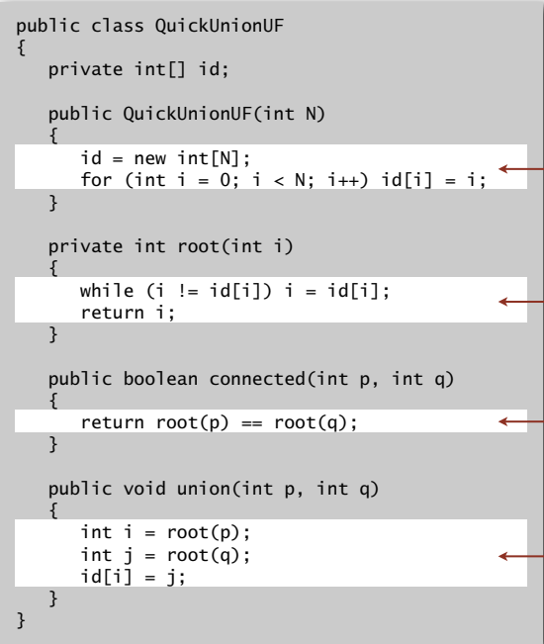
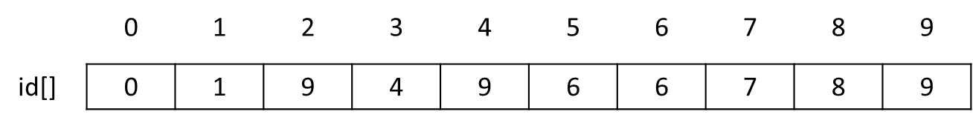
Quick-union: Java implementation
set id of each object to itself (N array accesses)
chase parent pointers until reach root
(depth of i array accesses)
check if p and q have same root
(depth of p and q array accesses)
change root of p to point to root of q
(depth of p and q array accesses)

Slide 29
Quick-Union is too slow
Cost model. Number of array accesses (for read or write).
algorithm | initialize | union | find
quick-find | N | N | 1
quick-union | N | N† | N
(worst)
† includes cost of finding roots
Quick-find defect.
・Union too expensive (N array accesses).
・Trees are flat, but too expensive to keep them flat.
Quick-union defect.
・Trees can get tall.
・Find too expensive (could be N array accesses).

Slide 30
Improvement 1: weighting
Weighted quick-union.
Modify quick-union to avoid tall trees.
Keep track of size of each tree (number of objects).
Balance by linking root of smaller tree to root of larger tree.

Slide 31
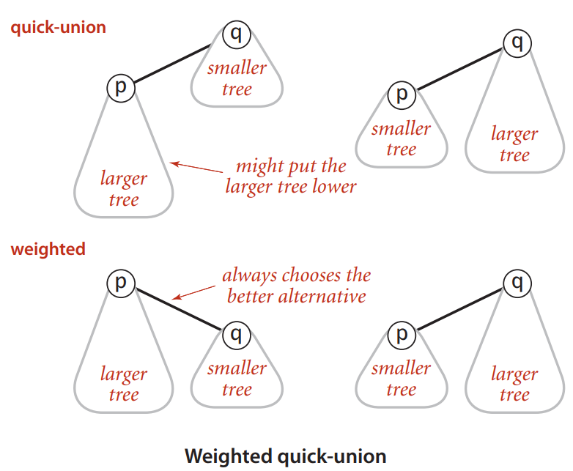
Improvement 1: weighting

Slide 32
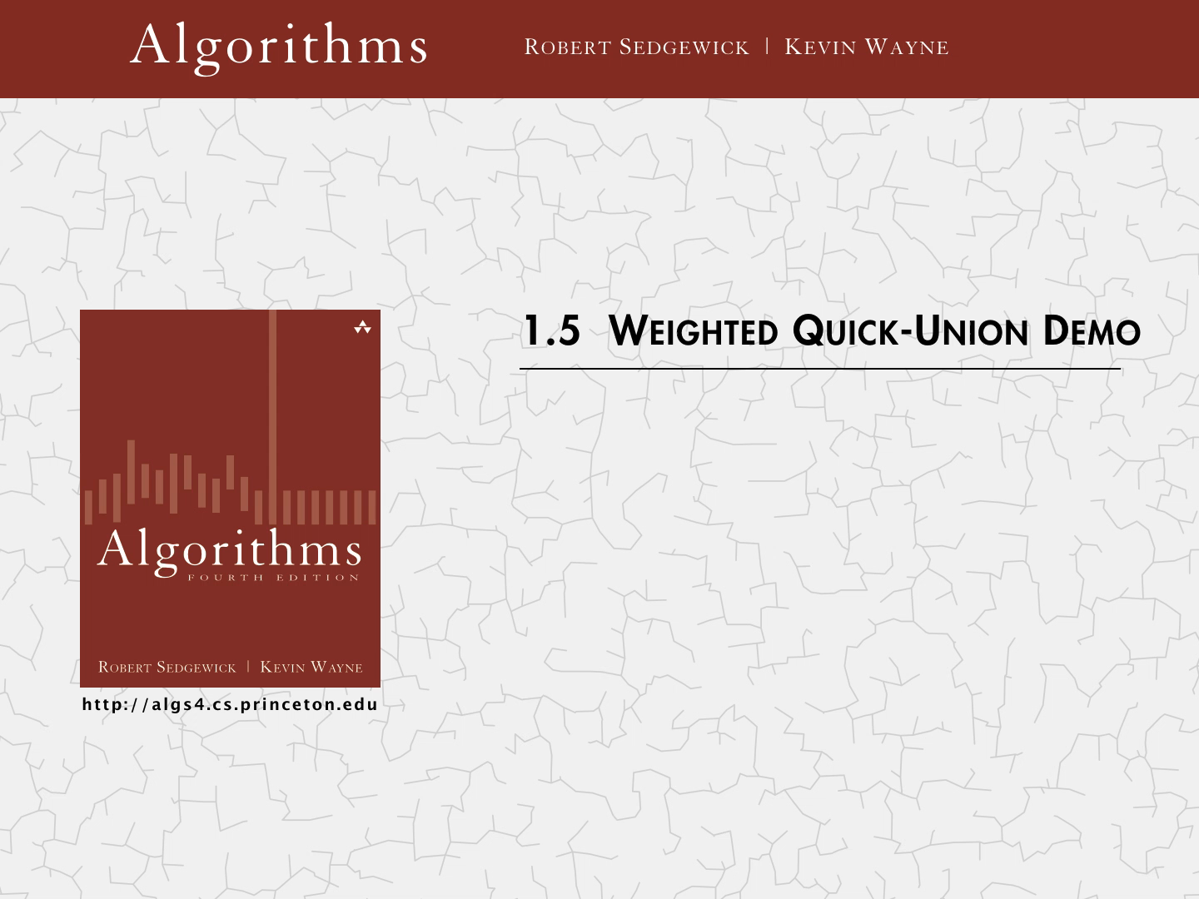

Slide 33
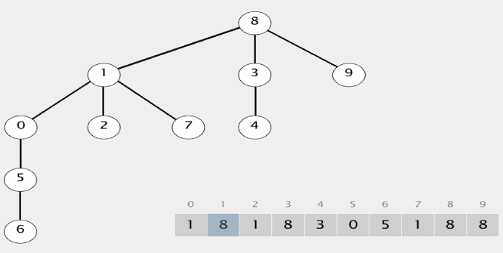
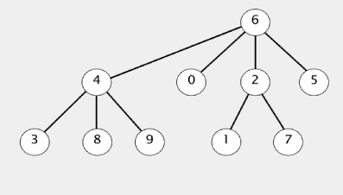
Improvement 1: weighting
Quick-union
Weighted quick-union

Slide 34
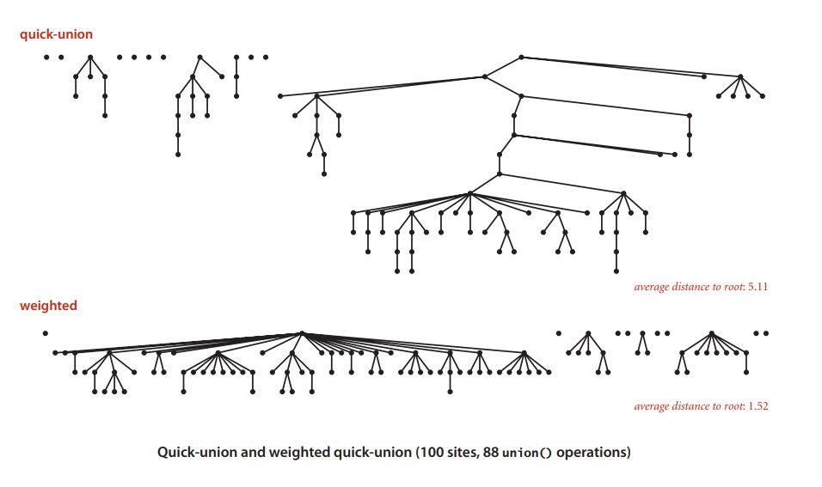
Quick-union and weighted quick-union example

Slide 35
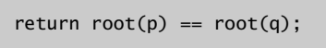
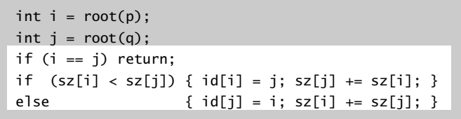
Weighted quick-union: Java implementation
Data structure. Same as quick-union, but maintain extra array sz[i] to count number of objects in the tree rooted at i.
Find. Identical to quick-union.
Union. Modify quick-union to:
Link root of smaller tree to root of larger tree.
Update the sz[] array.

Slide 36
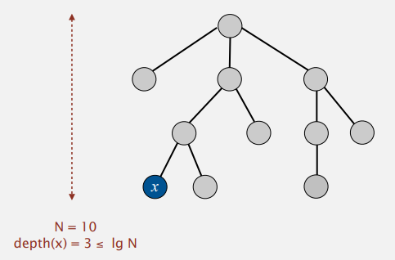
Weighted quick-union: Java implementation
Running time.
Find: takes time proportional to depth of p and q.
Union: takes constant time, given roots.
Proposition. Depth of any node x is at most lg N. (lg = base-2 logarithm)
Notes:
lg 1000 =10
Lg 1000000 = 20
Lg billion 30

Slide 37
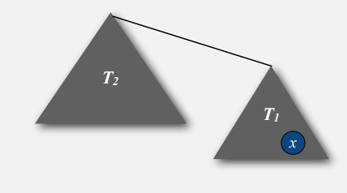
Weighted quick-union: Java implementation
Proposition. Depth of any node x is at most lg N. (lg = base-2 logarithm)
When does depth of x increase?
Increases by 1 when tree T1 containing x is merged into another tree T2.
The size of the tree containing x at least doubles since |T2| ≥ |T1|.
Size of tree containing x can double at most lg N times. Why?
Notes:
If you double a subtree Lg N time yomps reach N which is the size of the elements N.

Slide 38
Weighted quick-union analysis
Running time.
Find: takes time proportional to depth of p and q.
Union: takes constant time, given roots
algorithm | initialize | union | find
quick-find | N | N | 1
quick-union | N | N† | N
Weighted quick-union | N | lg N† | lg N
† includes cost of finding roots
Q. Stop here?
A. No, easy to improve further.
Notes:
If N=1 M then cost is 20
if N 1 billion then cost is 30.

Slide 39
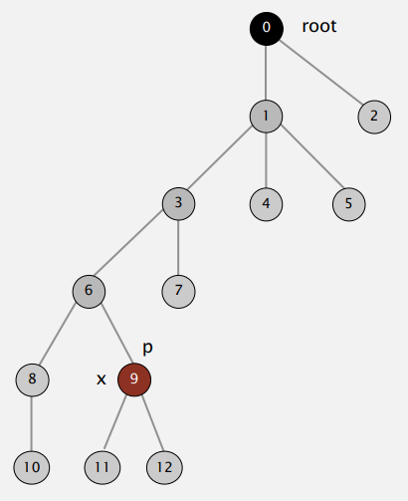
Improvement 2: path compression
Quick union with path compression. Just after computing the root of p, set the id of each examined node to point to that root.

Slide 40
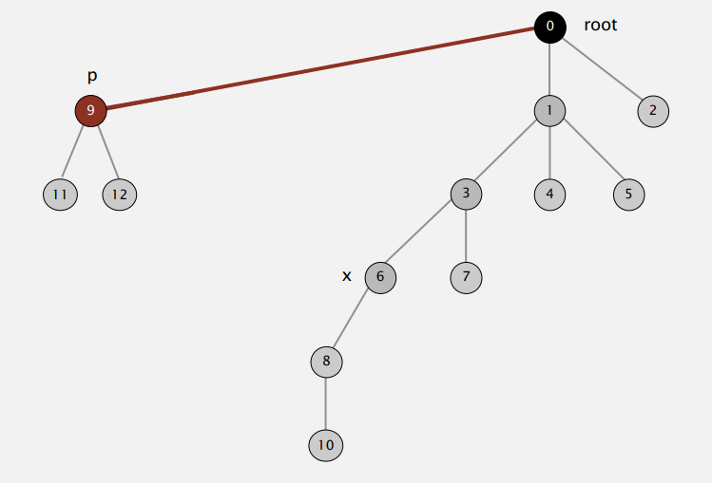
Improvement 2: path compression

Slide 41
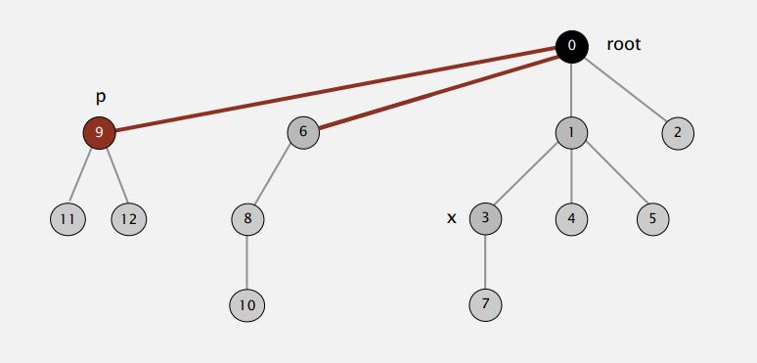
Improvement 2: path compression

Slide 42
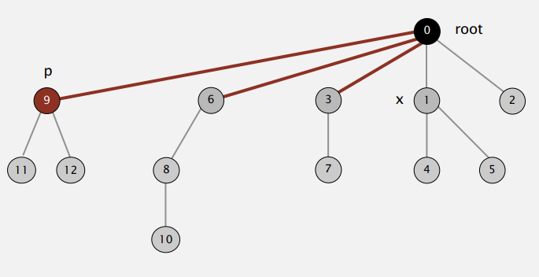
Improvement 2: path compression

Slide 43
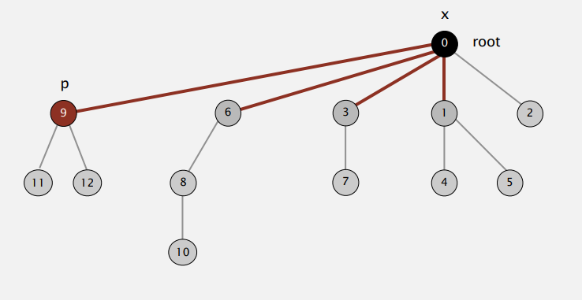
Improvement 2: path compression

Slide 44
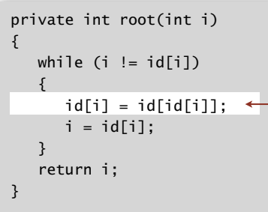

Path compression: Java implementation
Two-pass implementation: add second loop to root() to set the id[] of each examined node to the root.
Simpler one-pass variant: Make every other node in path point to its grandparent (thereby halving path length). This keep the trees almost flat.
only one extra line of code !

Slide 45
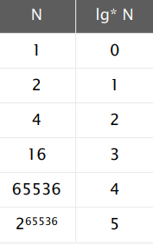
Weighted quick-union with path compression: amortized analysis
Proposition. [Hopcroft-Ulman, Tarjan] Starting from an empty data structure, any sequence of M union-find ops on N objects makes ≤ c ( N + M lg* N ) array accesses.
Analysis can be improved to N + M α(M, N).
Simple algorithm with fascinating mathematics.
Iterate log function
Notes:
Log* is a number of time you have to take log of N to get one. (Iterate log function)
The running time will in real-world linear.

Slide 46
Weighted quick-union with path compression: amortized analysis
Linear-time algorithm for M union-find ops on N objects?
Cost within constant factor of reading in the data.
In theory, WQUPC is not quite linear.
In practice, WQUPC is linear.
[Fredman-Saks] No linear-time algorithm exists. (in "cell-probe" model of computation)

Slide 47
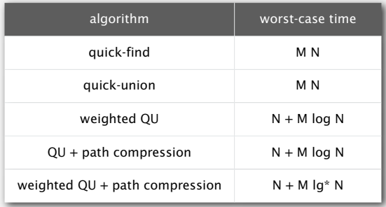
Summary
Bottom line. Weighted quick union (with path compression) makes it possible to solve problems that could not otherwise be addressed.
M union-find operations on a set of N objects

Slide 48
Summary
10⁹ unions and finds with 10⁹ objects
WQUPC reduces time from 30 years to 6 seconds.
Supercomputer won't help much; good algorithm enables solution.

Slide 49
Union-Find Summary
0 | 1 | 2 | 3 | 4 | 5 | 6 | 7 | 8 | 9
id[]
0 | 1 | 1 | 8 | 8 | 0 | 0 | 1 | 8 | 8
0 | 1 | 2 | 3 | 4 | 5 | 6 | 7 | 8 | 9
1 | 1 | 1 | 8 | 8 | 1 | 1 | 1 | 8 | 8
Quick Find

Slide 50
Union-Find Summary
Quick-union
Weighted quick-union

Slide 51
Union-Find Summary

